Slide 1
Python Fundamentals - Day 3
NumPy - Part 2

Slide 2
Review
The core data structure in NumPy is called an ndarray, which stands for "n-dimensional array."
The ndarray object represents a multidimensional, homogeneous array of fixed-size items.
It can be created using various methods provided by NumPy, such as using the numpy.array() function or by converting other Python sequences like lists into arrays.

Slide 3
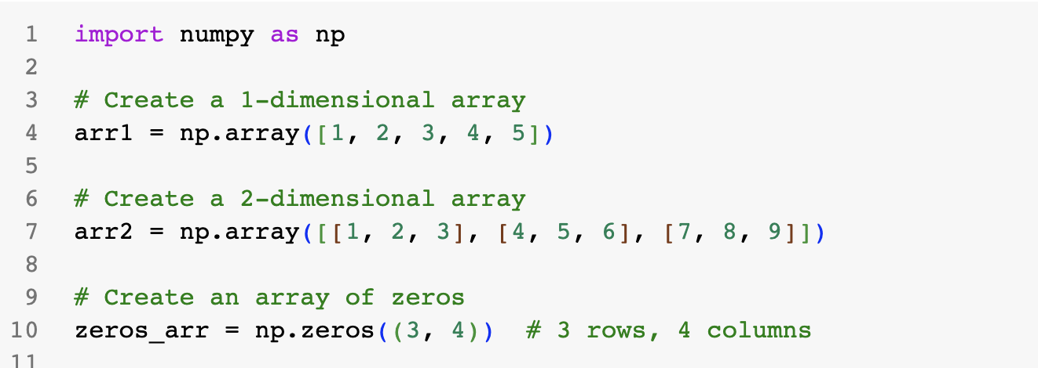

Slide 4
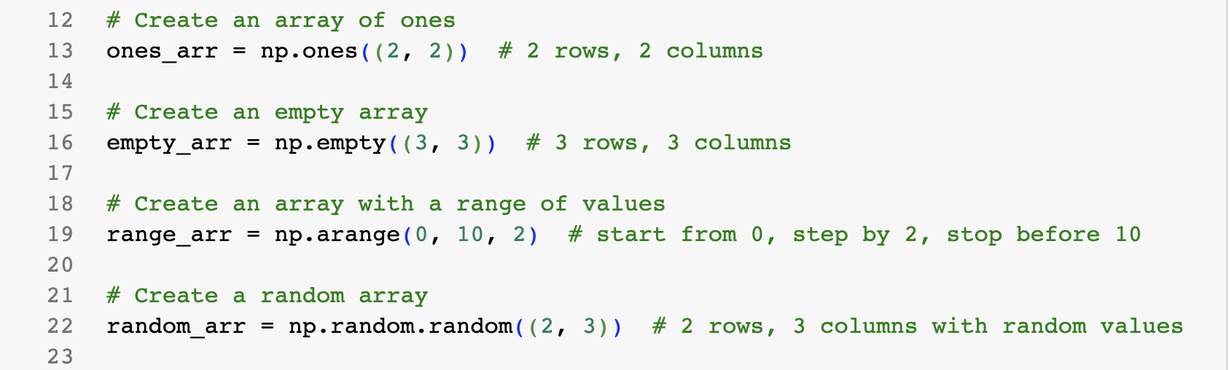

Slide 5
NumPy: Indexing and Slicing
Once you have created an ndarray, you can access and manipulate its elements using indexing and slicing, perform various mathematical operations, and apply functions to the array.
NumPy provides a wide range of functions and methods optimized for efficient array computations.

Slide 6
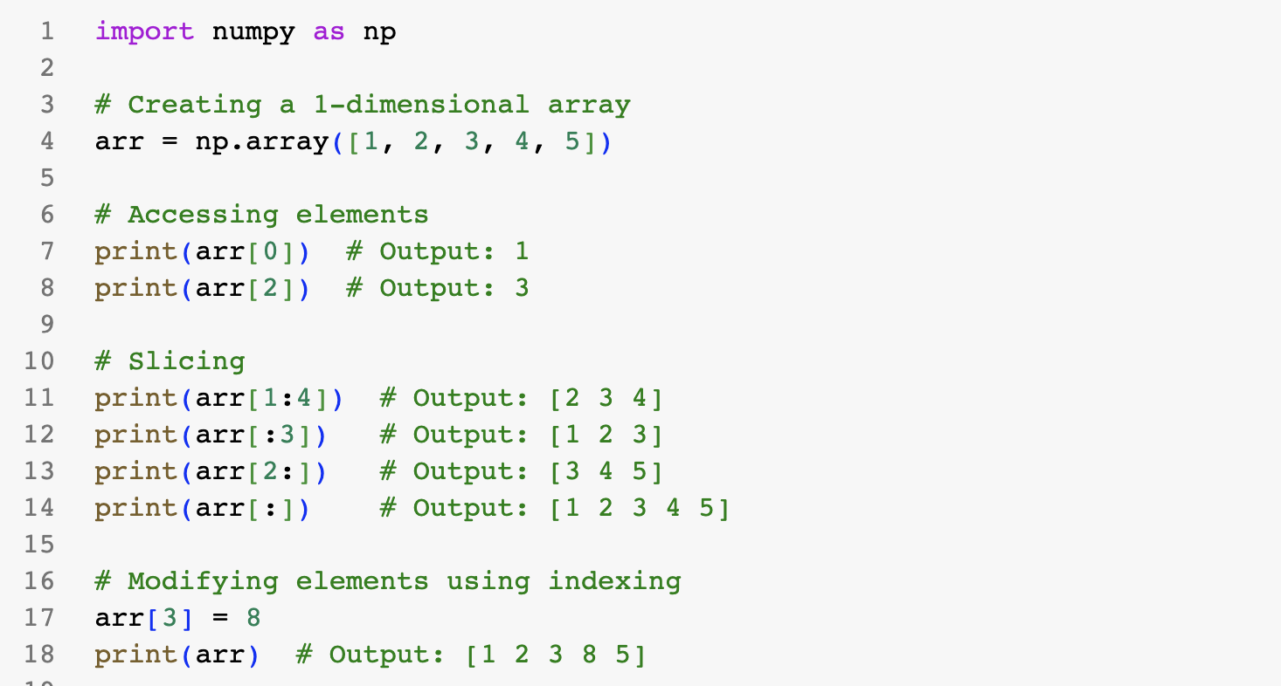

Slide 7
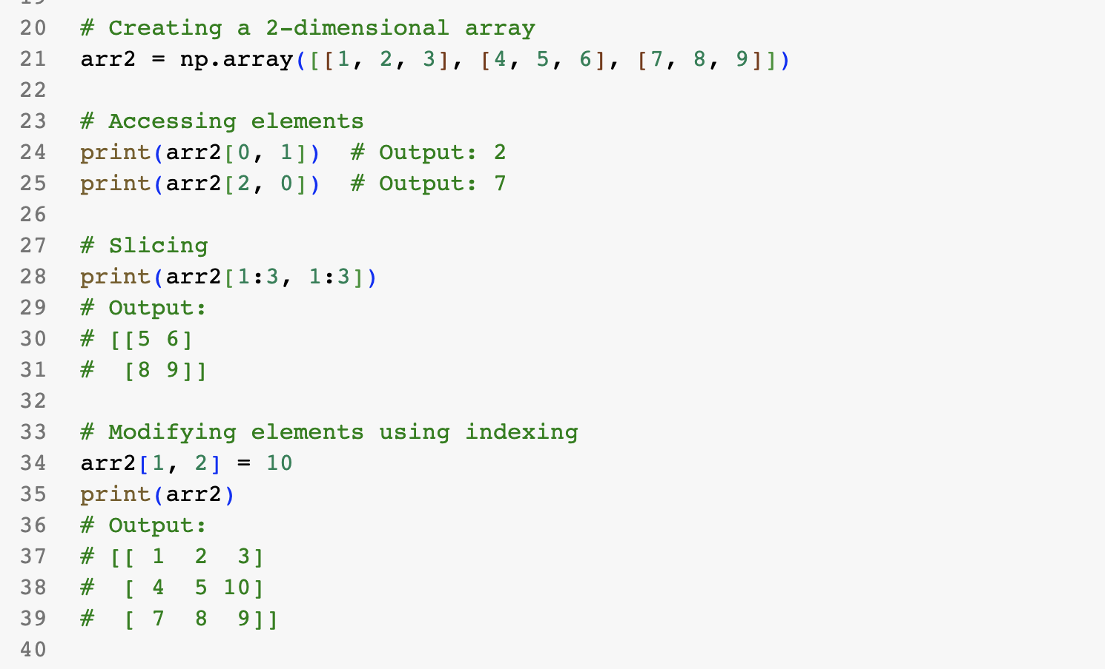

Slide 8
NumPy Exercise 1
Link: https://docs.google.com/document/d/1uK0l73SvjYT66CqQt9MQJa5vJ_tya8KG1z2eVShma7M/edit?usp=sharing

Slide 9
NumPy - Stacking
NumPy provides functions to vertically stack arrays as rows or horizontally stack arrays as columns.

Slide 10
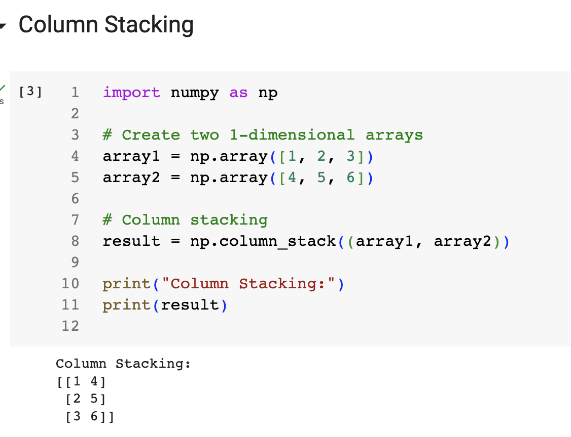

Slide 11
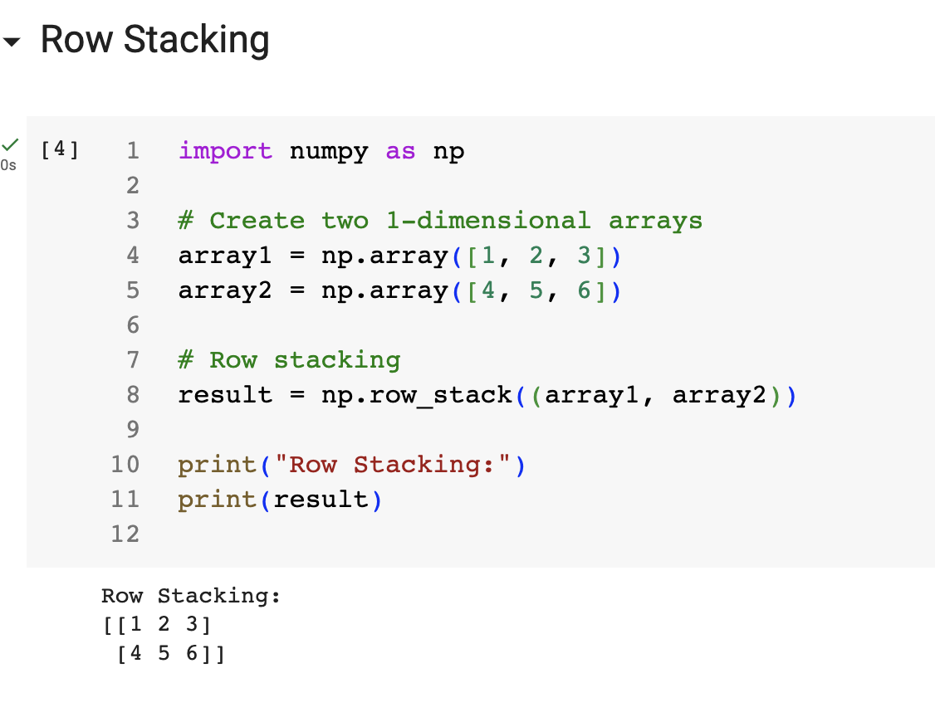

Slide 12
NumPy - Exercise 2
Link: https://docs.google.com/document/d/1y4swlg6SCWCAI8e1DMFVGWaTOO6n28DICzsmdllhgF4/edit?usp=sharing

